Slide 1
Hoeffding Option Tree Regressor
Ümit Bora Gökbakan
Ng Man Chun (Jay)

Slide 2
Theory: Hoeffding Trees and Options
Why Hoeffding Tree?
Data stream → cannot build optimal decision tree
Hoeffding Trees approx. optimal decision trees (within a bound)
Why add options?
Split condition: wait till best feature >> second best → slow growth
Don’t wait for clear best feature: explore all options (good split conditions)
Notes:
Speaking points:
Data streams are continuous
Not access to all data immediately
Decision tree not optimal at beginning of stream (optimal = make best decisions given all data)
Hoeffding Trees are built progressively

Slide 3
Theory: Hoeffding Tree Regressor
Build tree progressively (Hoeffding)
Final product (Tree Regressor)
regular decision tree
leaf nodes are regression models (linear) → locally linear approx. of solution

Slide 4
Lifeline of a Hoeffding Tree
Learning
Single initial leaf node, learn linear regr. on incoming data
One (and only one) feature emerges: splitting on it increases leaf merit by at least the Hoeffding Bound
more than the second best feature
Split leaf, tree grows
Pass next incoming data to single correct leaf node via decisions in tree
Predicting
Pass data to correct leaf via decisions
Evaluate data using linear regressor at leaf

Slide 5
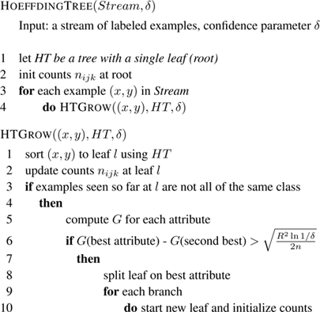
Dealing with Ties
It may happen that two similarly good splits are proposed. In this case we may:
Split on the best attribute if the Hoeffding bound is lower than some threshold:
Split on both proposals, and construct separate subtrees for each option.
Fig 1 The vanilla Hoeffding Tree algorithm does not deal with ties
Notes:
How to avoid over splitting? Set minimum merit (var reduction) for split, set grace period (min number of seen data)

Slide 6
Lifeline of a Hoeffding Option Tree
Learning
Single initial leaf node, learn linear regr. on incoming data
One or more features emerge: splitting on them reduces variance
Split leaf, tree grows
Pass next incoming data to correct leaf node, propagate down all options
Predicting
Pass data to correct leaves (multiple) via decisions
Evaluate data using linear regressor at leaves → multiple outputs
Aggregate the outputs
Notes:
How to avoid over splitting? Set minimum merit (var reduction) for split, set grace period (min number of seen data)

Slide 7
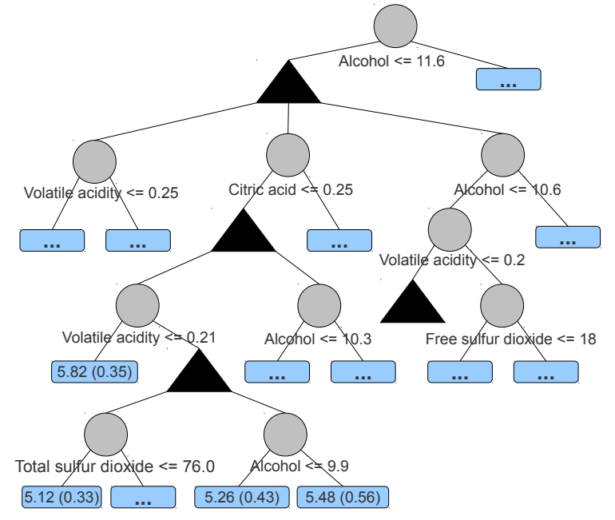
1.
2-3.
4.
Fig 2 Upon encountering options, we walk down each of them, and aggregate every leaf reached

Slide 8
Option Tree vs beam search
Similarity
Less greedy than simple greedy search
Difference
Beam search keeps fixed beam width
Option tree beam size can only grow

Slide 9
Findings from Option Tree Paper
Option trees converge much faster (than HT)
Option trees reach slightly higher accuracy*
Prediction rule:
Average of leaves vs Best Tree
Transcribe “best tree” using best branch among options
Best tree has same size as HT
Best tree: Lower bias, higher variance
Large memory size
Decay max number of branches for option nodes by level of tree
Set max level where options are allowed
* not statistically significant
Notes:
Best tree = lowest prequential error

Slide 10
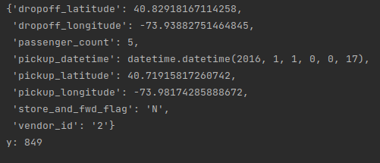
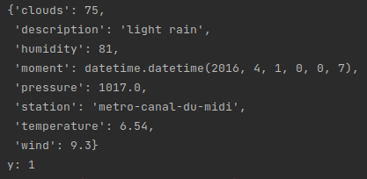
Sample Data
Fig 4 Taxi Dataset
Fig 5 Bikes dataset
Notes:
Best tree = lowest prequential error

Slide 11
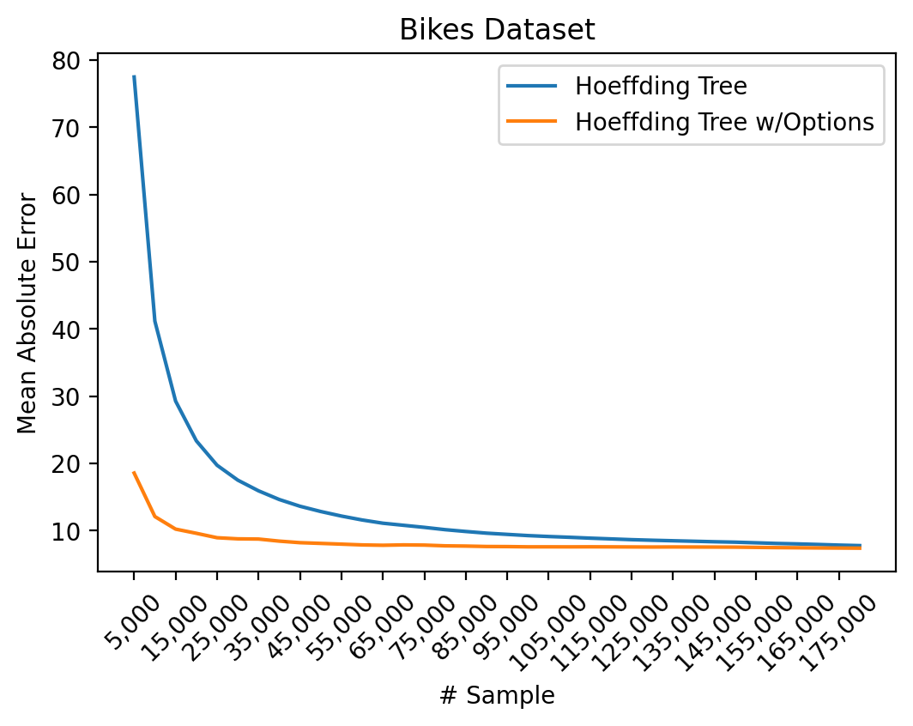
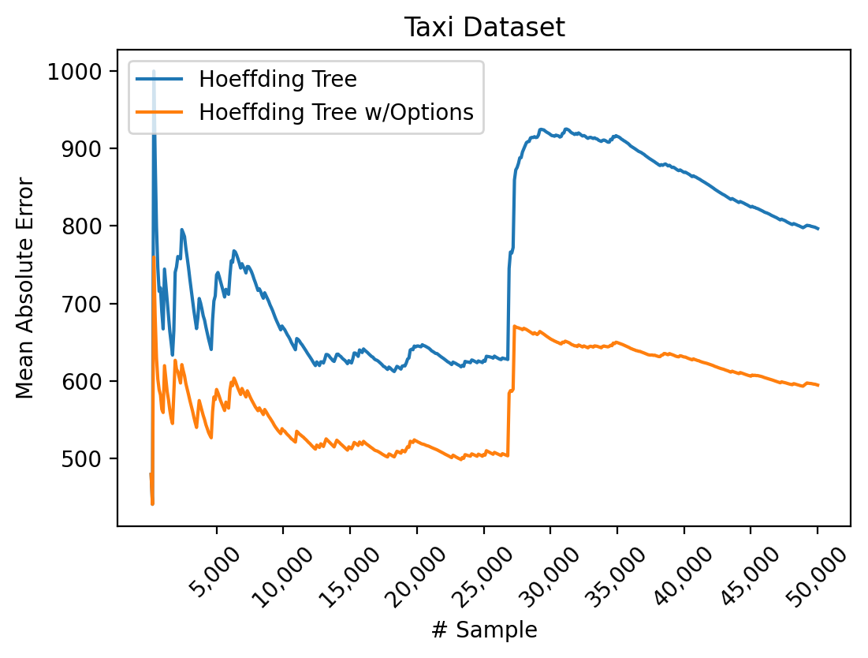
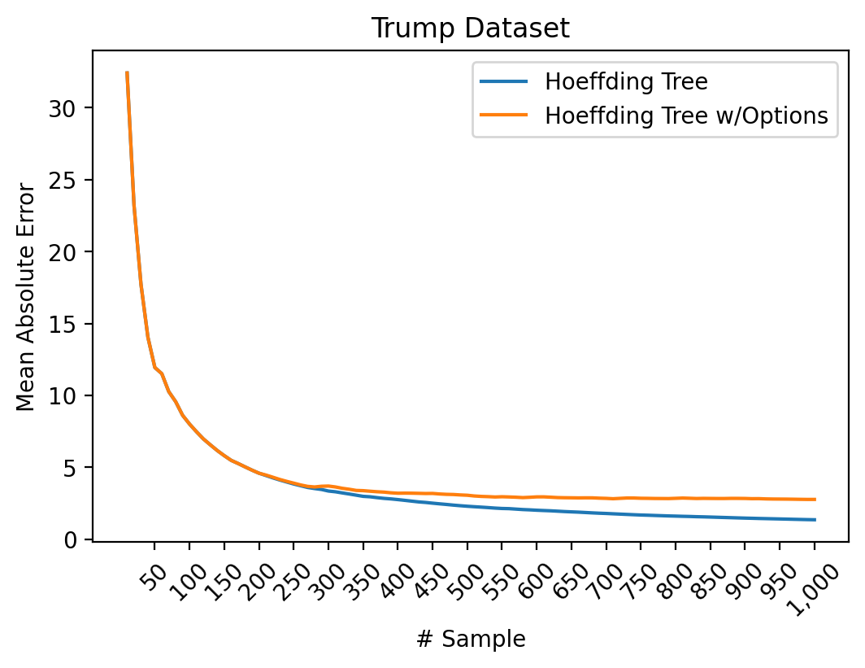
Experiments
Fig 3 Hoeffding Trees converge much faster with Options on the Bikes dataset.
Fig 4 Hoeffding Trees achieve better results with Options on the Taxi dataset.
Fig 5 Hoeffding Trees achieve slightly worse results with Options on the Trump Approval dataset.
Notes:
Best tree = lowest prequential error

